Slide 1



Selectivity to multiple task variables induced by sequence learning in the mouse somatosensory and posterior parietal cortex
Maravall Lab

Slide 2
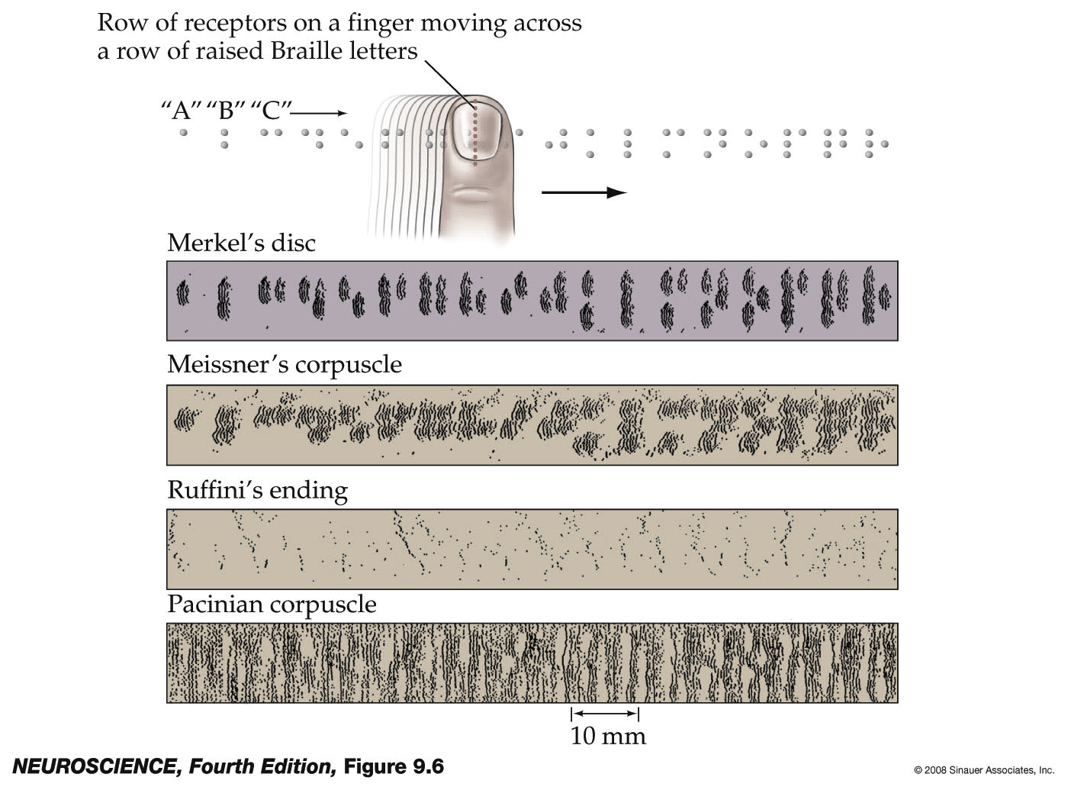
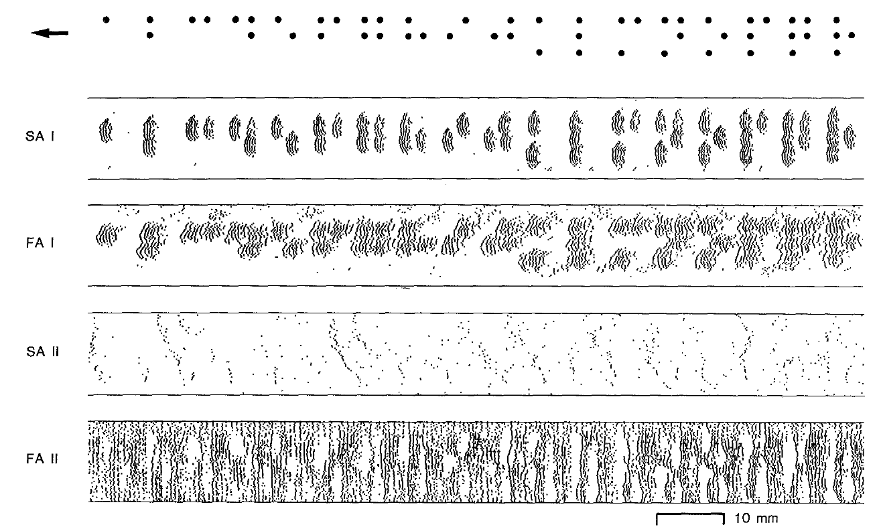
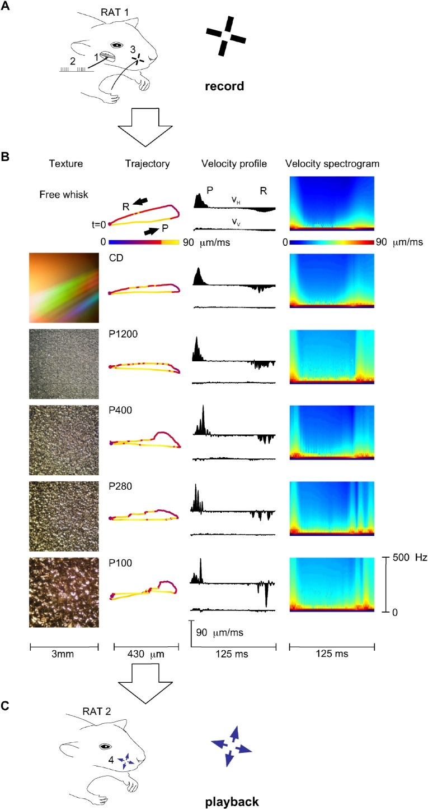

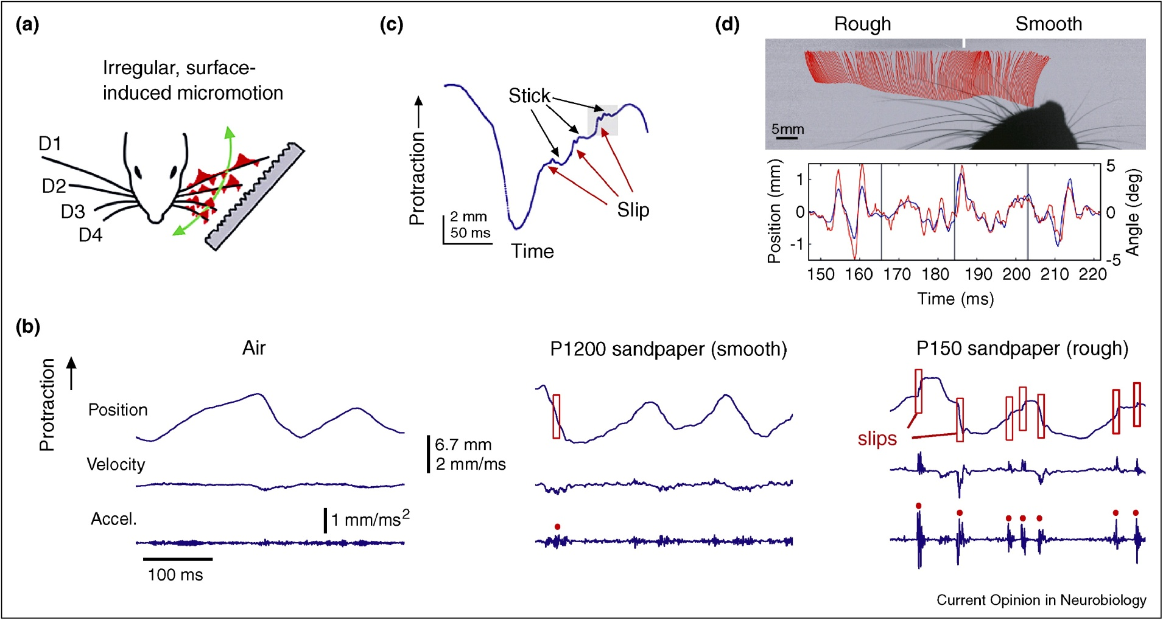
The world around us consists of temporally patterned stimuli
To make sense of the world, neurons in sensory pathways need to discriminate between temporal sequences of spikes
Phillips et al, 1990
Jadhav & Feldman, 2010
Notes:
In the world around us, natural stimuli unfold over time, and their temporal structure is key to making sense of them. To recognise the song Paul McCartney is playing here, it’s not enough to detect the individual notes – we need to know when they happen relative to each other. Similarly, to decipher his utterances, we need to know the correct order of the phonemes.
The brain is stunningly good at recognising stimuli with sequential structure, whether the temporal pattern is imposed from the outside or set by our own active sensing – as, for example, when our fingertip scans across a spatial Braille pattern, giving rise to a *TEMPORAL* pattern of concatenated spiking that must then be decoded, with reference to what the finger was doing.
How does the brain process and classify sensory sequences? This is a fundamental question in neuroscience, and its implications touch on levels from neuronal circuit organisation and dynamics, to perception and language processing.

Slide 3
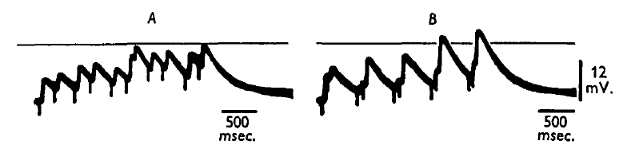
How does sequence learning affect cortical codes?
Single neurons and dendrites can be readily selective for temporal patterns
Does learning a sequence change neuronal selectivity (e.g. temporal integration)?
How do neurons reflect the identity of a sequence (e.g. categorical responses)?
Segundo et al, 1963
Notes:
Yet how the activity of neurons in an intact brain distinguishes between learned sequences is unknown. We need to determine, with single-neuron resolution in a behaving animal, how recognition of a meaningful sensory sequence is reflected in neuronal activity and classified.

Slide 4
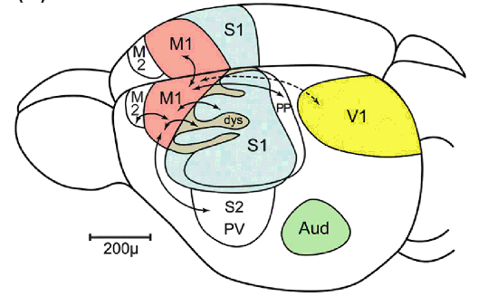
Cortical pathway for tactile sequence information
S1bf
VGAT mice
473 nm
Young et al. In: Watson, Paxinos & Puelles, eds., 2012

Slide 5
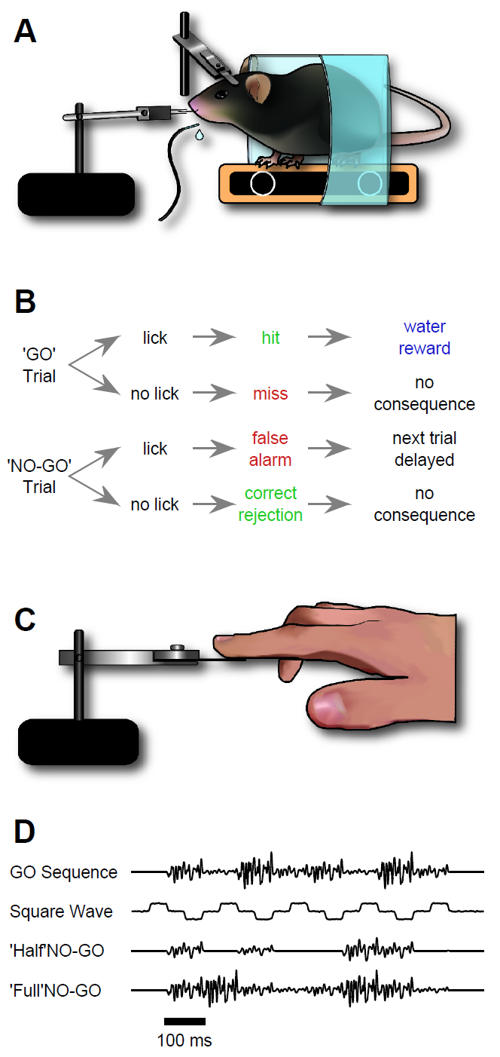
Training mice to recognise a particular sequence
opto
2P
ephys
Target (GO)
sequence
response
outcome
vs
100 ms
lick - hit
REWARD
GO
NO-GO
no lick - miss
no conseq
NO-GO
lick - false alarm
DELAY
no lick - correct rej
no conseq
Mice, and humans, distinguish arbitrary sequences defined solely by temporal patterning
Learning transfers rapidly across whiskers, fingers or sensory modalities
Notes:
The paradigm involves behavioural learning to recognise a sequence that differs from others only in the ordering of its elements. In mouse experiments, sequences are delivered to the animal’s whiskers. Mice communicate detection of the sequence by licking for a water reward.
These are *EXAMPLES* of sequences initially used within the training paradigm. They have structure on multiple timescales and several cues could be used to distinguish them.
The paradigm is suitable also for humans and allows us to meaningfully compare the cues used by both species.
It is also adaptable to auditory stimulation, allowing for comparison across sensory modalities as well.
And we have now combined it with cutting-edge techniques for recording and manipulating neural activity, including electrophysiology, 2p imaging or optogenetics. All are now established in my lab, extending across multiple cortical regions.

Slide 6
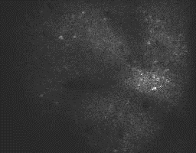
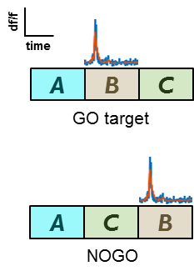

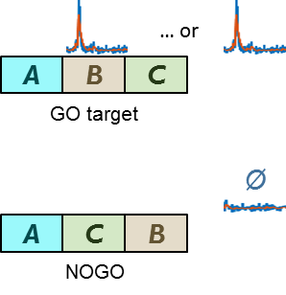

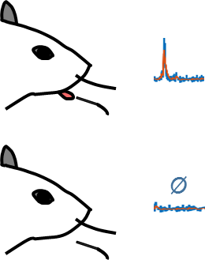
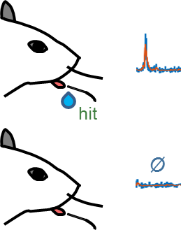
Searching for sequence selectivity
sensory feature detector
categorical sensory
(both on hit & miss trials)
Ø
GCaMP6f, Thy1 mice, layer 2/3
decision, action or lick selective
reward selective
Ø
Ø
Notes:
Object perception and discrimination are often understood in a hierarchical framework where sensory neurons respond to elementary physical properties of a stimulus while higher-order neurons are selective to more abstract features that identify the object.
So sensory encoder neurons respond to local physical events or features in the stimulus whenever they appear.
We know that neurons in the somatosensory pathway and primary somatosensory cortex respond like this.
“PREDICTIVE”

Slide 7
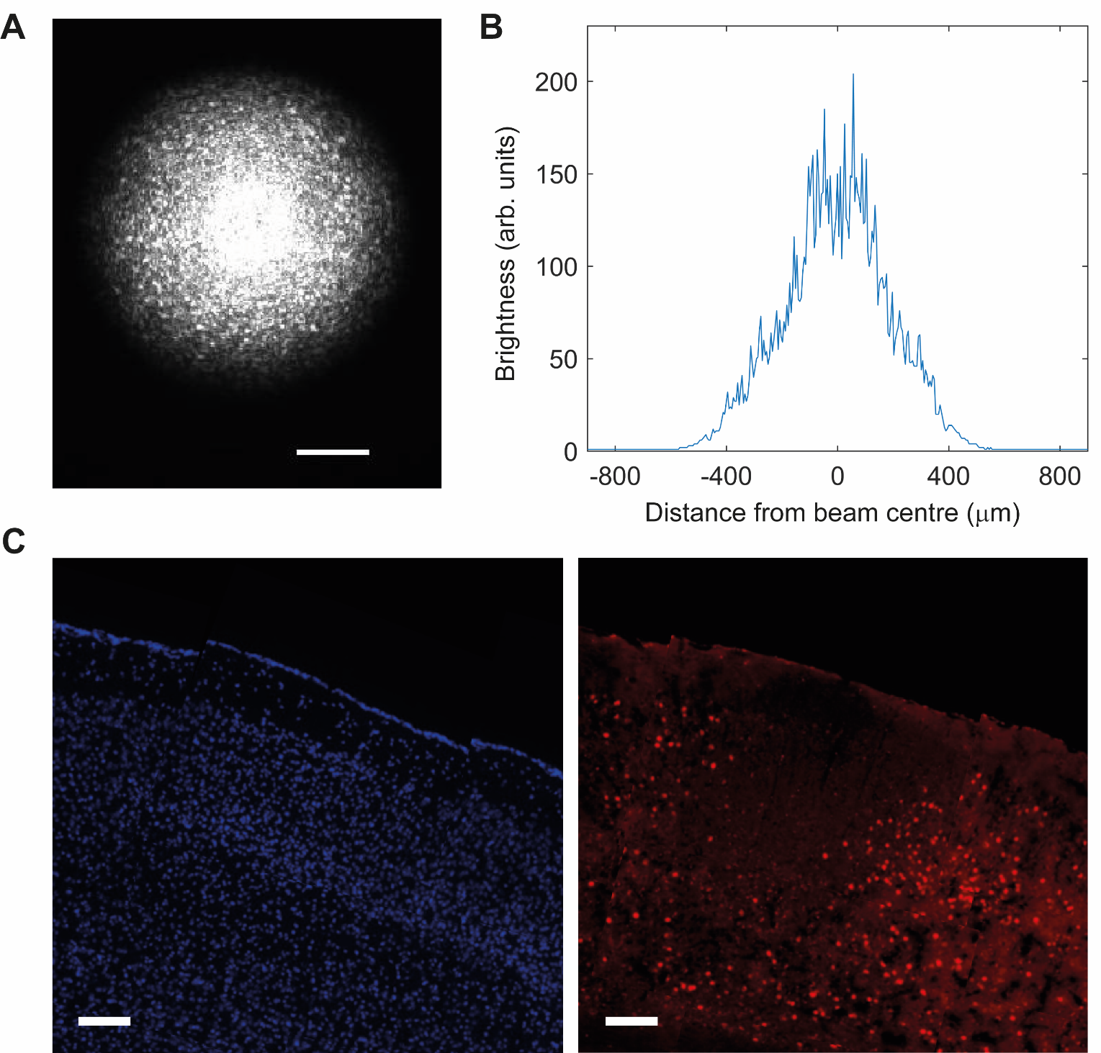

Slide 8
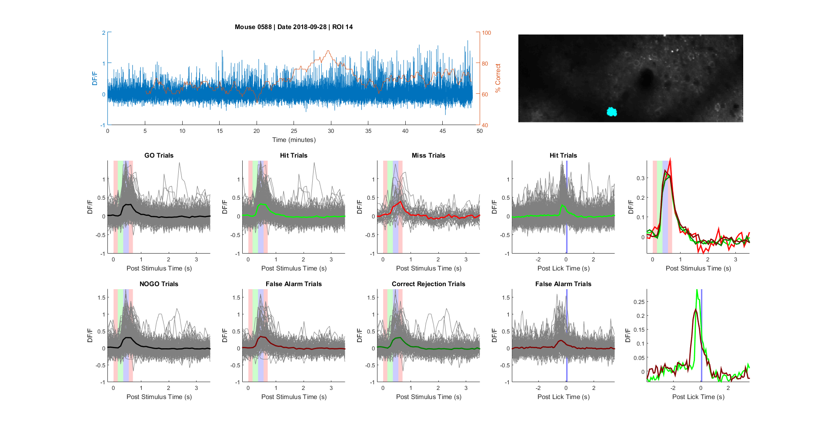
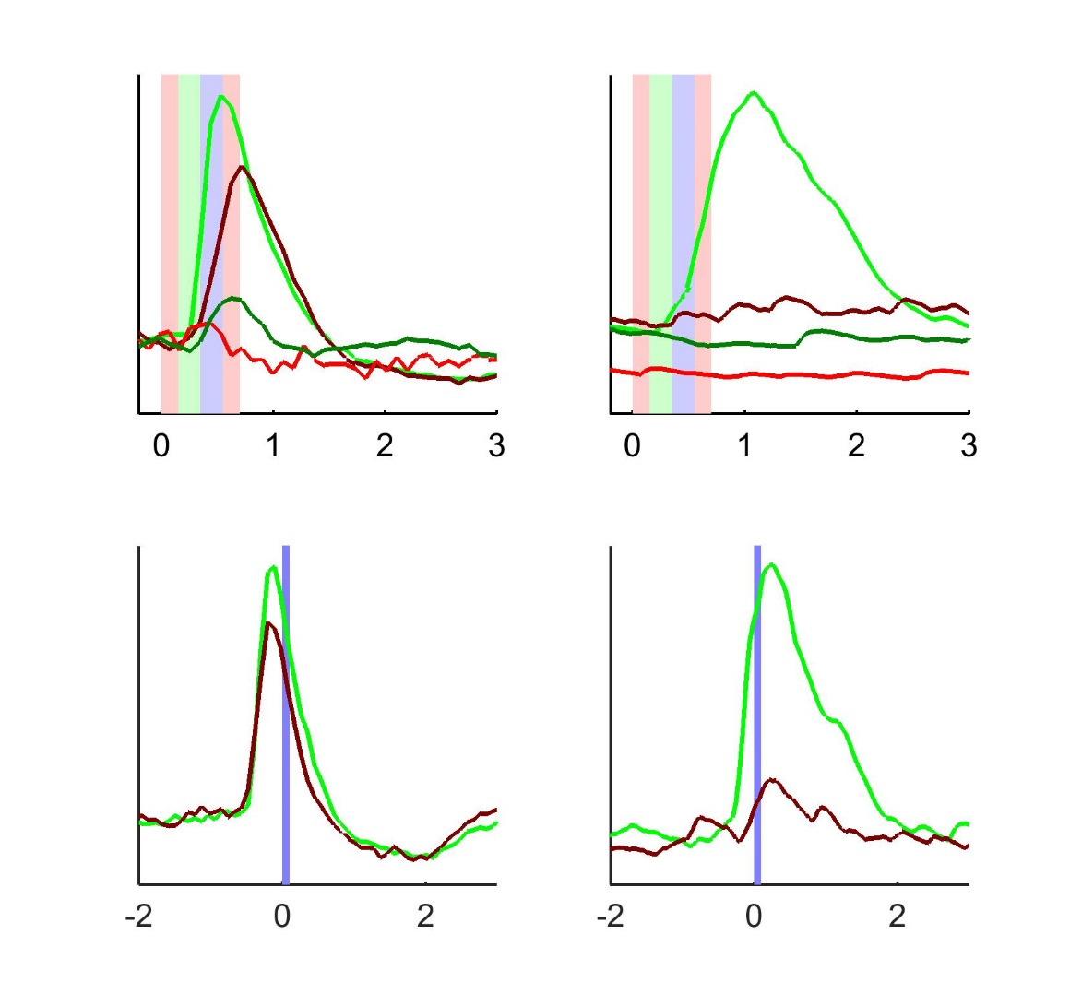


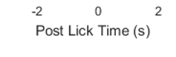
Diverse S1bf responses reflect multiple task variables
GCaMP6f, Thy1 mice, layer 2/3
sensory
(non-selective, indiscriminate)
decision/action/motor
outcome
(hits – rewarded)
hit
miss
CR
FA
DF/F
DF/F
Post Stimulus Time (s)
DF/F
DF/F
Post Lick Time (s)
Sensory information is heterogeneously mixed in with multiple other task signals
Notes:
Object perception and discrimination are often understood in a hierarchical framework where sensory neurons respond to elementary physical properties of a stimulus while higher-order neurons are selective to more abstract features that identify the object.
So sensory encoder neurons respond to local physical events or features in the stimulus whenever they appear.
We know that neurons in the somatosensory pathway and primary somatosensory cortex respond like this.
“PREDICTIVE”

Slide 9
What are the neurons encoding?
Expect neurons at each brain area to encode different features
RNN classification with different classification identities
go/nogo; lick/nolick; hit/fa
Running window analysis
Data unbalance
Significance calculation
stimulation
licks / reward collection

Slide 10
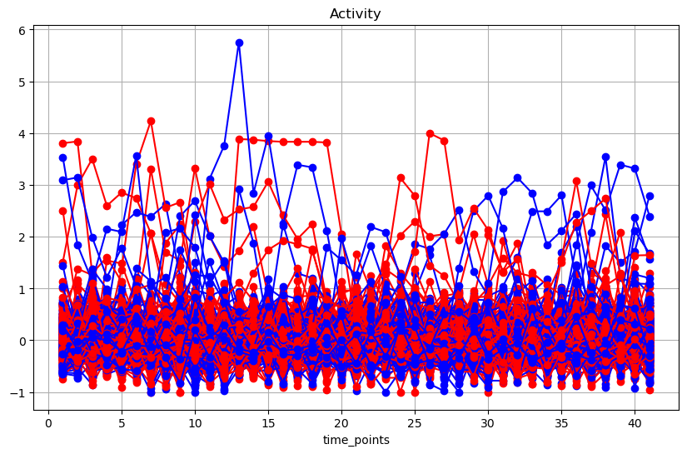
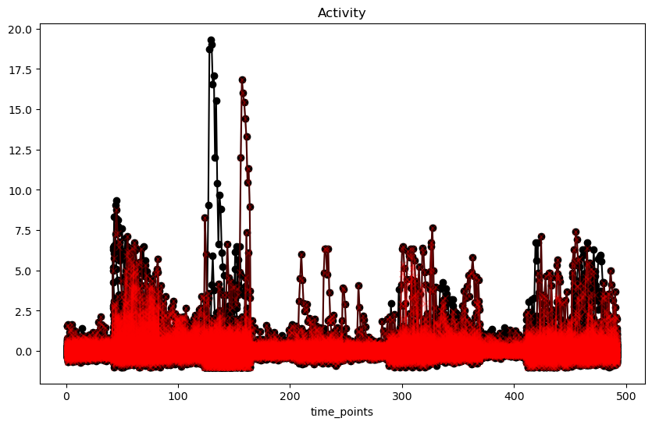
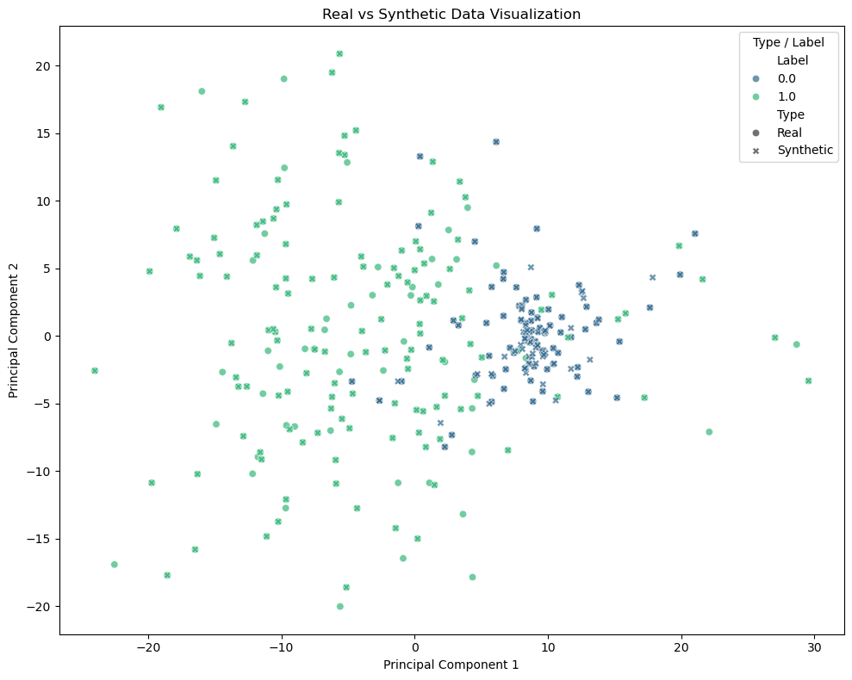
Data pre processing
DF

Slide 11
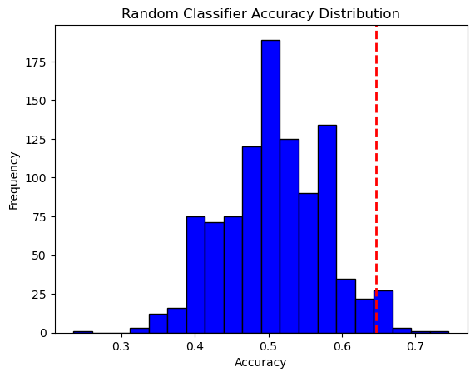
Calculating significance of RNN decoding accuracy

Slide 12
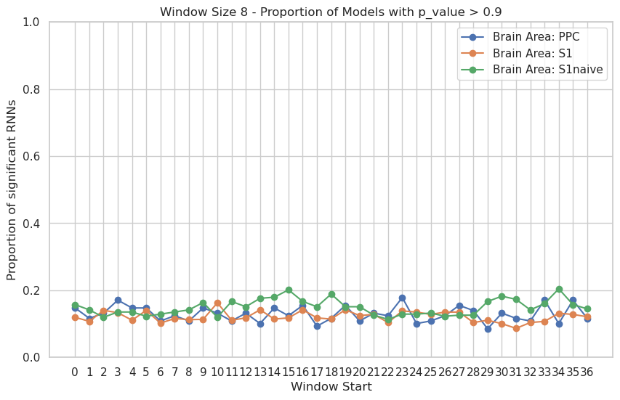

Slide 13
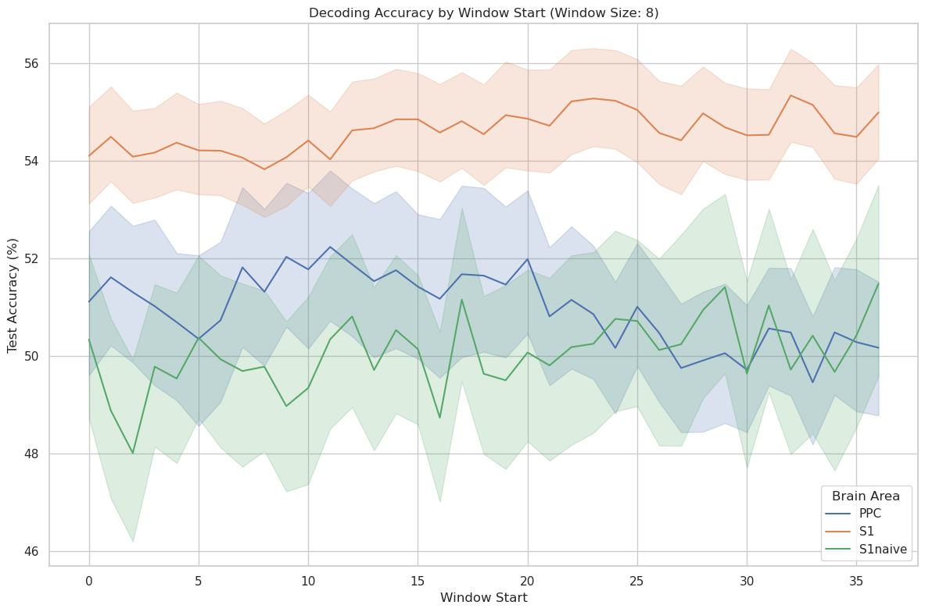
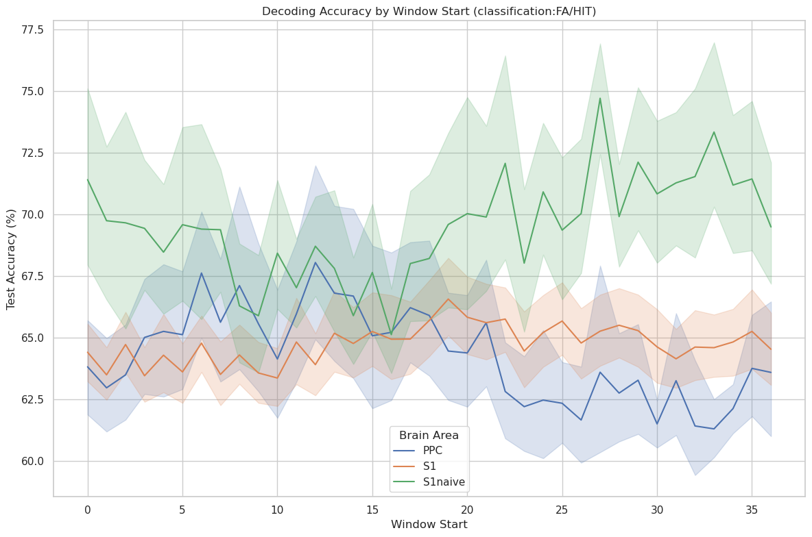
Running Window Analysis -single neuron
stimulation
licks / reward collection
stimulation
licks / reward collection
All neurons
Significant neurons

Slide 14
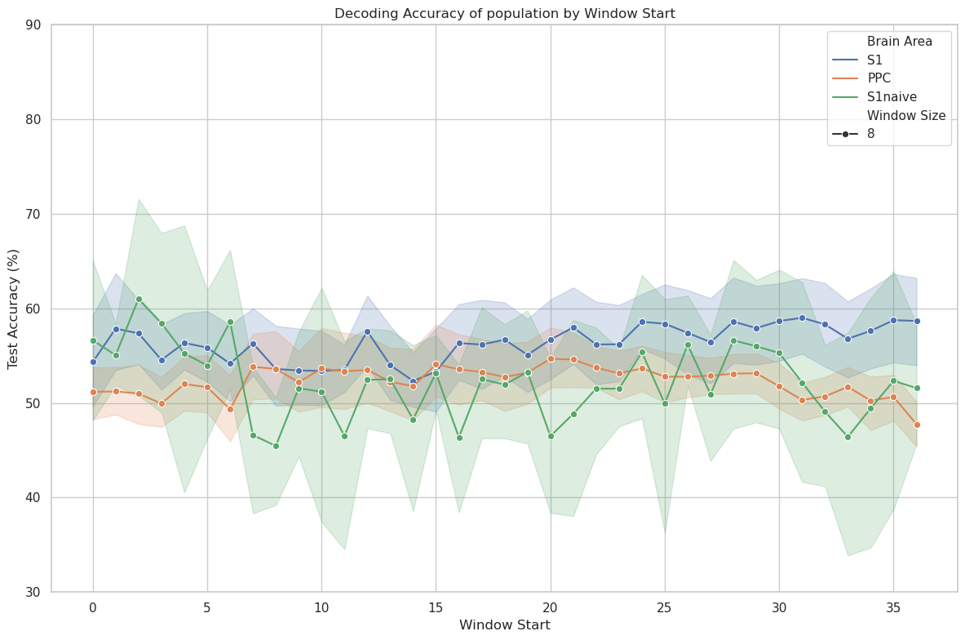
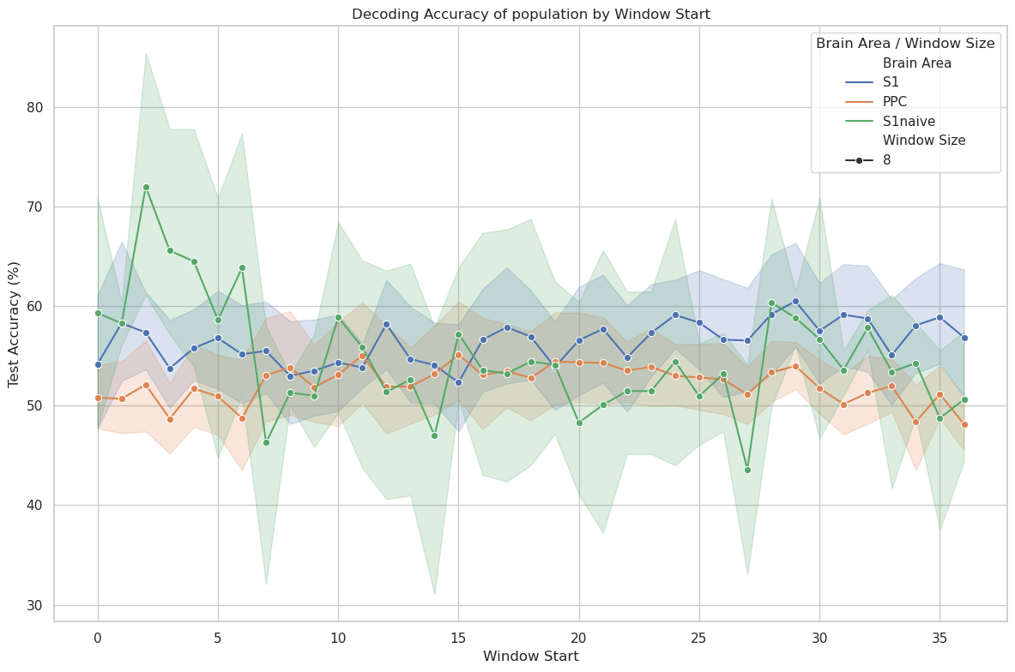
Running Window Analysis -population
stimulation
licks / reward collection
stimulation
licks / reward collection
All sessions
Only first 2 naive sessions

Slide 15
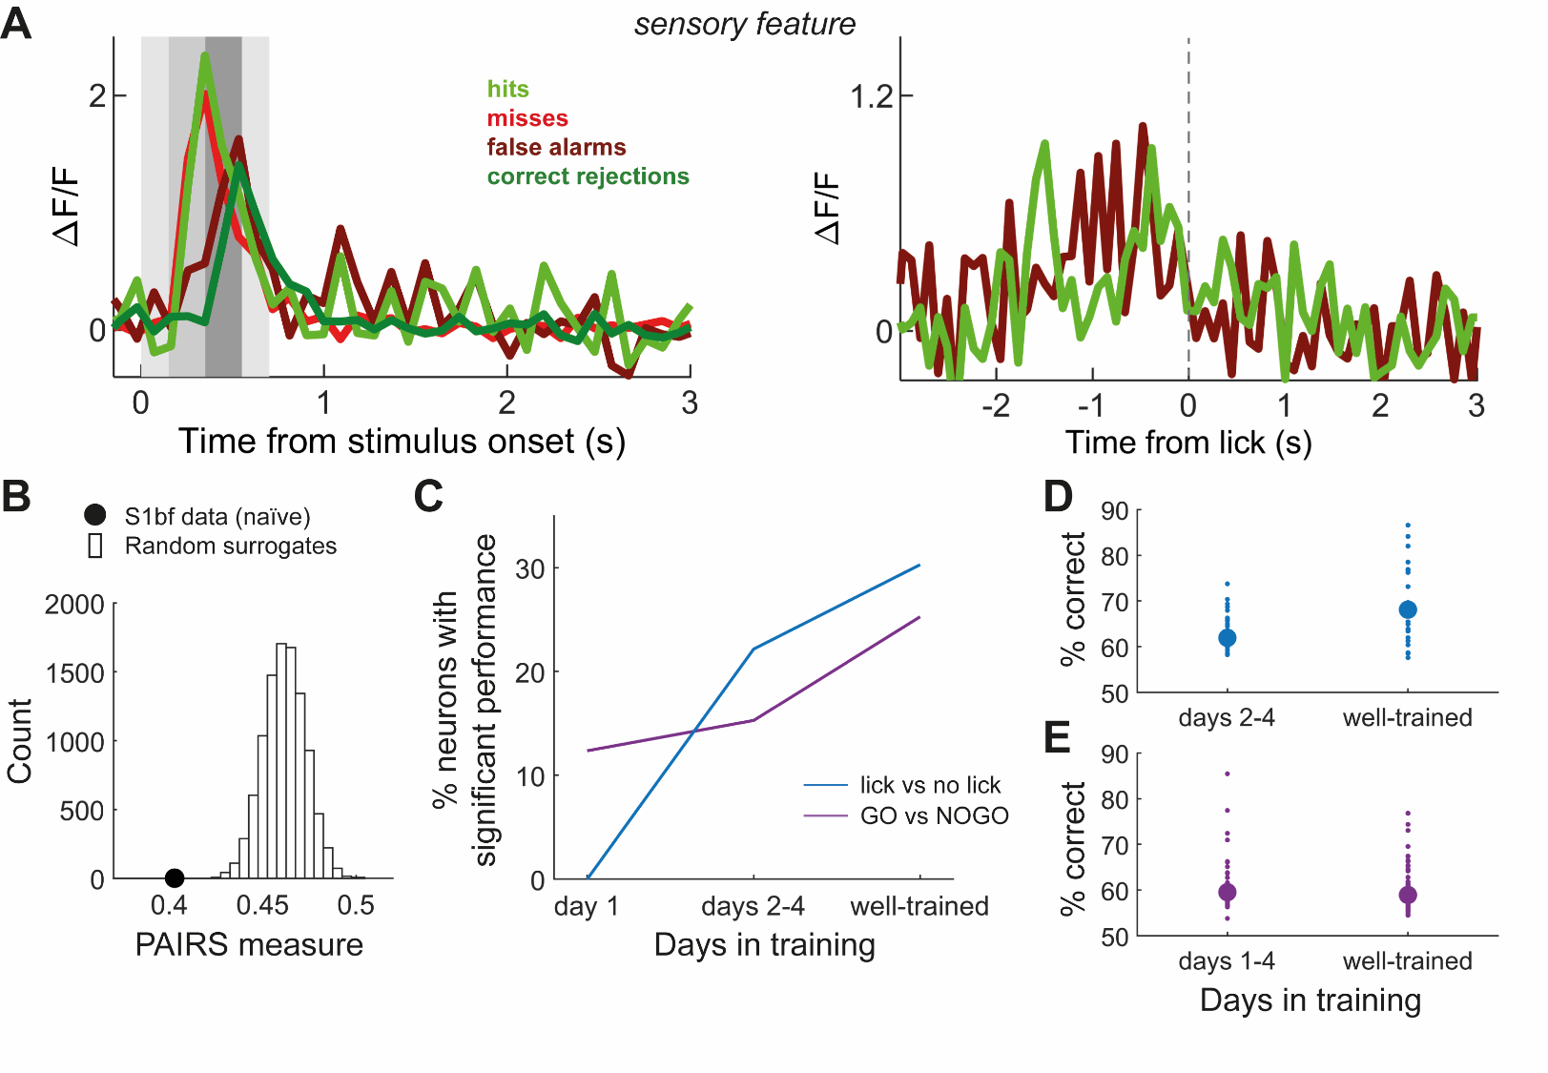
How does training change tuning in S1bf neurons?
In this task decision/action tuning is refined by learning (neurons predict the learned action upon training), but sensory tuning isn’t
Michael Bale
Paul Kinghorn

Slide 16
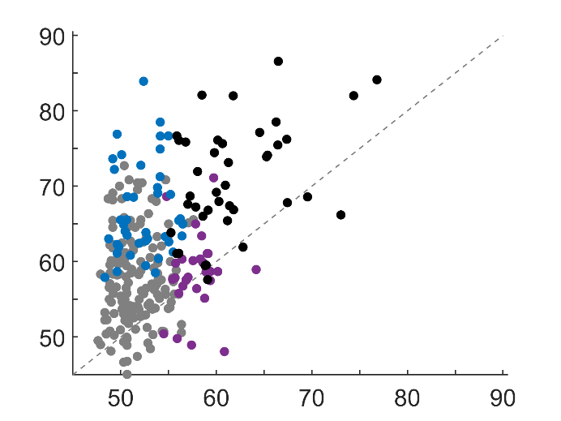
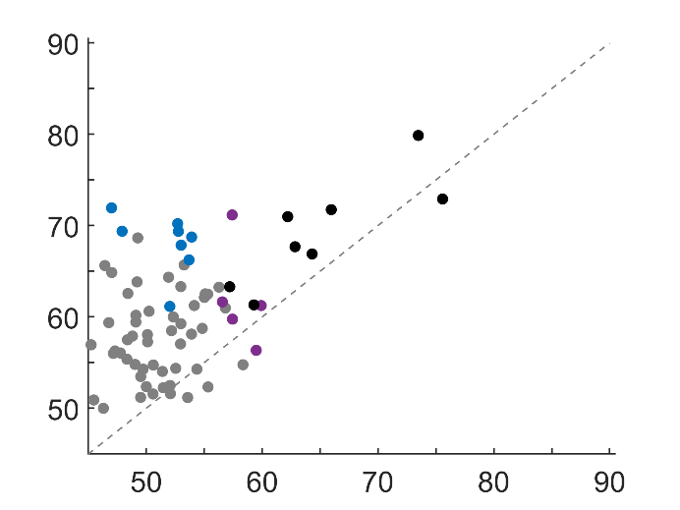
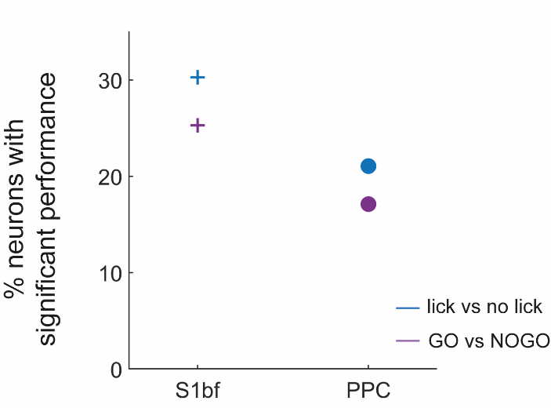
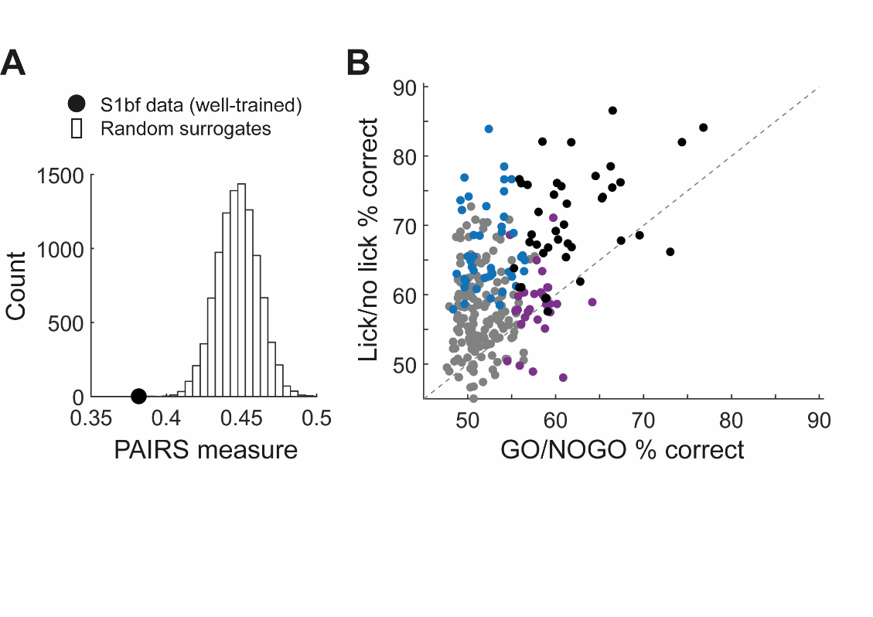
Sensory information or action?
S1bf
PPC
Michael Bale
Paul Kinghorn
Notes:
Object perception and discrimination are often understood in a hierarchical framework where sensory neurons respond to elementary physical properties of a stimulus while higher-order neurons are selective to more abstract features that identify the object.
So sensory encoder neurons respond to local physical events or features in the stimulus whenever they appear.
We know that neurons in the somatosensory pathway and primary somatosensory cortex respond like this.
“PREDICTIVE”

Slide 17
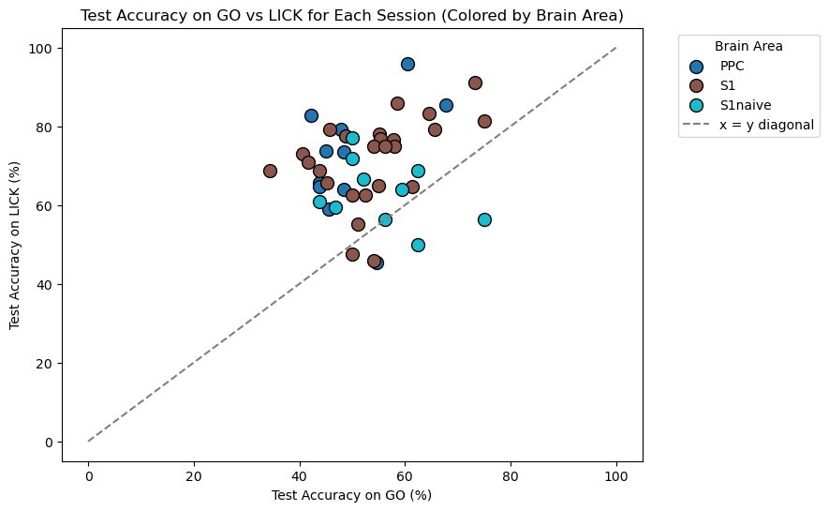
Population vs Single neuron

Slide 18
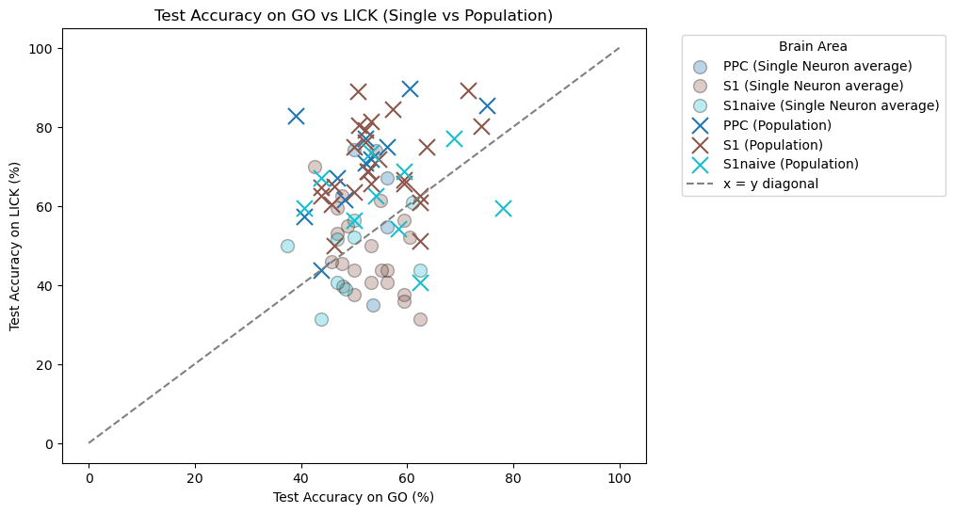

Slide 19
Summary
Like humans, mice can discriminate tactile stimulus sequences distinguishable by the ordering of their elements
Sensory info is routed through a cortical pathway involving S1bf and S2
Upon conditioned learning of a sequence, layer 2/3 neurons in S1bf are heterogeneous and reflect multiple task parameters including decision, motor, expectancy or reward
Non-sensory neurons could have a direct causal role or be a special case of “affordance encoding”
Non-sensory responses can also enhance collective sensory coding; perception likely arises from a combination of sensory and non-sensory signals
Task info, especially sensory, is broadcast to PPC even though not needed here – PPC as repository of potentially relevant association variables
Notes:
Does performance at sequence recognition use universal cues or do the cues depend on learned, modality- or species-specific experience?

